Slide 1
Semantic Database
Concept
Prototype
Implementation

Slide 2
Concept
Current database technologies
Relational (RDBMS)
NoSQL (document)
Graph (node-edge)

Slide 3
Relational Databases
Tables
Container for loosely associated fields
Fields
Typed data values
Foreign Keys
Loose associations between tables
1:1, 1:n, m:n

Slide 4
NoSQL Databases
Document-based
Key-value pairs (JSON)
Type-less
Unstructured associations between K-V pairs
Each relationship de-reference requires a round trip to the server (no joins)

Slide 5
Graph Database
A node is a concrete instance
A node can have attributes
Nodes are associated with other nodes (unidirectional, bidirectional) through “edges”
Edges can have attributes
Still under consideration as an underlying architecture

Slide 6
Semantic Database What Is This?
First, we need to take a step back.
What is “Semantics?”

Slide 7
Semantics The branch of linguistics and logic concerned with meaning
Formal Semantics
Logical aspects of meaning:
Sense
Reference
Implication
Logical form
Lexical Semantics
Word meanings
Word relations
Conceptual Semantics
Cognitive structure of meaning

Slide 8
Semantics
The study of meaning
Focuses on relationship between:
Signifiers: words, phrases, signs and symbols
Denotation: what they stand for
“No word has a value that can be identified independently of what else is in its vicinity.” (de Saussure, Ferdinand, 1916, The Course of General Linguistics)

Slide 9
Semantic Database (Take Two)
Schema
Describes denotations (concepts?)
Describes relationships between denotations
Relationship -> Structure -> Hierarchy -> Graph
Associates signifiers (values) to denotations
Structure resolves to concrete properties to which instance values can be associated
Implemented as language/database native types
However, in a semantic database, the structure is instantiated for each instance.

Slide 10
Relational Database
Defines a “structure”, for example:
Table: RSS_Feed_Item
Fields:
Name : string
Title : string
URL : string
Note how the field names are mostly high level abstractions
“select URL from RSS_Feed_Item”
Returns string values in all rows
The structure (semantic context) is completely lost

Slide 11
Semantic Database
Defines Structures:
RSS_Feed_Item
RSS_Feed_Name
Text
Value : string
RSS_Feed_Title
Title
Text
Value: String
RSS_Feed_URL
URL
Value : String
“select URL from RSS Feed Item”
Returns the structure and the value for each row:
RSS_Feed_Item.RSS_Feed_URL.URL.Value = [value]
“Every word has a value that is identified with what else is in its vicinity.”

Slide 12
Semantic Database
Queries can be made at any level in the structure, however this incrementally loses meaning:
“select URL from RSS_Feed_Url”
Some contextual loss
URL is no longer identified as being an RSS Feed URL
Returns “Url.Value” structure-values
“select Value from URL”
Complete contextual loss
Would return a collection of strings
This is the equivalent of the RDBMS query:
“select Value from RSS_Feed_Item”
In a semantic database, this query is actually not possible!

Slide 13
However!
A semantic database can be built on top of an RDBMS.
We can leverage:
foreign key constraints
server-side joins
unique key constraints
Unique key indexing
NoSQL does not offer any of these benefits

Slide 14
What Does Semantic + RDBMS Look Like?
Tables represent structure
Foreign keys describe sub-structures
Joins are used to join together structures
All-null native types takes on a specific meaning:
There is no structure instance

Slide 15
RDBMS vs. Semantic Database
RDBMS:
Relationships are driven by:
Cardinality
Normalization rules
“Logical” decoupling of field associations
The result are associations that are not semantic but rather abstracted un-natural structural relationships, leading to complex model diagrams
Relationships are (ideally) restricted to established foreign keys
Semantic Database:
Relationships are driven by:
The semantic structure itself
The result is semantic associations that are emergent as new semantic structures are created

Slide 16
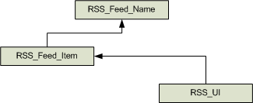
Example: RDBMS
RSS_Feed_Name
Name : text
RSS_Feed_Item
Title : text
Description : text
PubDate : date
Url : text
FK_RSS_Feed_Name
RSS_UI
FK_RSS_Feed_Item
Displayed
Visited

Slide 17
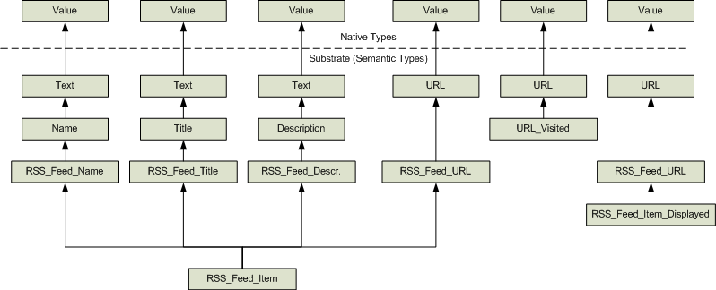
Unfolded Semantic Structure
This looks horribly complex but it’s actually a simple tree structure

Slide 18
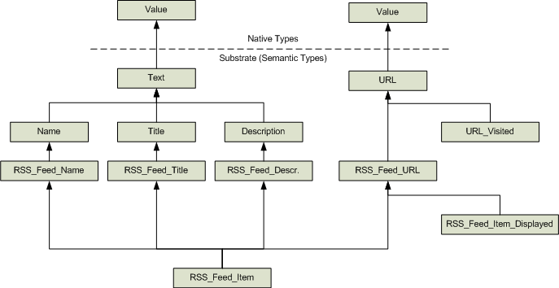
Hierarchical View

Slide 19
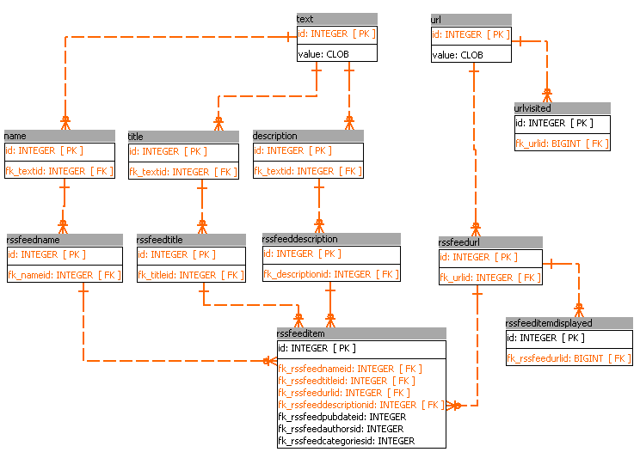
Semantic Database Schema in an RDBMS

Slide 20
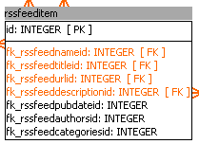

Things to Notice
The “deepest” semantic types are almost always composed just of foreign keys.
Tables with native types are very “thin”, having very few fields.

Slide 21
So What?
We can now ask:
What are all the URL’s recorded in the system?
What are the URL’s we have visited?
What URL’s are associated with feeds?
What are all the values of “Title”?
What are all the feed names?
Etc.

Slide 22
Joining Two or More Semantic Types
A new ST hierarchy is dynamically created:

Slide 23
Benefits of a Semantic Database
By preserving semantic structure, we can query the database at different levels of semantic meaning, from very specific to very general.
For example, the semantic type “Title” is very general but allows us to ask “what are all the values of things having the meaning “Title”?
By inspecting the relationships, we can ask “what are the things having “Title” in their meaning?
When we query the database, we don’t just get back a list of records – we get back fully “rehydrated” semantic types.
In other words, the need for a separate ORM is eliminated:
We pass in semantic structures as actual C# objects
We get back semantic structures as actual C# objects

Slide 24
Drawbacks of a Semantic Database
Tables and their fields are organized by hierarchical rather than logical structure:
We usually think about organizing information into logical associations and relationships
Hierarchical organization creates many more tables
The number of joins in a query can degrade performance.
Multiple insert operations are required to create the semantic type’s hierarchy.
Designing hierarchies isn’t easy
We need to learn how to think about multiple levels of abstraction.
We need to think carefully about unique native types and unique semantic types.
Writing SQL queries by hand is painful:
lots of joins, often with multiple references to the native type tables making it hard to keep track of which FK join is associated with what meaning-value.
Writing insert statements by hand is even more painful:
multiple inserts from the bottom up, requiring the ID of the child table to populate the foreign key in the parent table.

Slide 25
Addressing Drawbacks
A Semantic Database engine can address some of these drawbacks:
Automating SQL query generation
Hides the hierarchy and table joins
Automating SQL inserts
Managing all the necessary FK ID’s
Improving Performance
Caching queries so the engine doesn’t have to re-create the SQL statement every time.
Use prepared statements so the server isn’t parsing and analyzing the query statement every time it’s used.

Slide 26
Time for a Demonstration: An RSS Feed Reader
We’ve already explored some of the core semantic types
We will use the Higher Order Programming Environment to demonstrate the:
Semantic Database engine
Semantic Types
User Interface
Queries
We will inspect some of the actual SQL statements

